Slide 1

Purpose
Real life scenario: I have a set of reports to refresh every month but data is only available at any day during Day 3 – 5 at beginning of each month. What do I do to make it easier?
This poster illustrates my solution to the scenario above that…
Leverages ODS output, Email Access and built-in SAS EG Scheduler to …
Set up an automatic process from data availability check to email delivery on final reports
In an effort to save time & efforts for repeated work.
Hope you will learn a bit of something new after reading this poster!

Slide 2
Basic Reporting Framework
(All done in SAS)
Trigger
Main Code Module
SAS ODS
Output
Reports
SMTP
access
"Data not available"
Email Check
Point 1
Email Check
Point 2
"Code completed with error. Check log"
"Data available. Report is running now"

Slide 3
Trigger
Designed to start (if data is available) and to end (if code has run successfully in last iteration)
How it works for our case -
Schedule the SAS project to run each day on Day 3 – 5 of each month
Check if a 'trigger file' exist – 'Have I run this project for this month?'
If answer is NO: Check if data is available; only run the remaining of the project if data is ready.
Save a 'trigger file' which could be read in next iteration to decide question in Step 2.
Does trigger file 201903 exist?
YES
No action
NO
Is data available?
YES
Go to main module
NO
Reports
No action
Trigger_ File_201903
(Avoid duplicate efforts in next iteration)

Slide 4
Tips on Main Code Module
Think of it as one 'task' instead of hundreds of code lines…
1. Macro your libraries – easy to organize (and to 'transition' to others too!)
2. Use %include – easy to slice and dice, debug and arrange your long, long code.
3. Save a copy of SAS EG for editing; one simpler version for scheduling to run.
/*define libname*/
libname code 'M:\Katie_Zheng\_Code';
libname output 'M:\Pivot Creation\_Output';
/*generate pathname macro*/
%let path2code = %sysfunc(pathname(code));
%let path2output = %sysfunc(pathname(output));
/* Read code*/
%include "&path2code\Macro_Prep.sas";
/* Exporting data */
%let vint_f="&path2output\portfolio_tracking_output.csv";
proc export data=temp dbms=csv outfile= &vint_f. replace ;run ;

Slide 5
SAS ODS Output
There are so many formats!
Note 1: Choose format based on your reporting need
A simple text email or attach a detailed report?
One pager or multiple pages?
Tables and charts?
Note 2: Be careful with sensitive data -
always check company policy before saving/outputting your data
Summary data v/s. account-level data details?
Customer data - PII?
Example – a xml file with 2 pages of tables:
ods tagsets.excelXP file ='&path2output\Digital_Acq_Summary.xml'
options(sheet_interval ='no' sheet_name ='Vol Summary' embedded_titles = 'yes');
/*Page 1*/
title 'Volume Summary';
proc print data=vol_summary;run;
title;
/*Page 2*/
ods tagsets.ExcelXP options(sheet_interval='proc' sheet_name ='Volume by Segment' embedded_titles = 'yes');
title "Volume by segment";
proc print data=vol_by_seg;run;
ods _all_ close;

Slide 6
SAS Email Method - SMTP
Format 1: With attachment
Format 2: Content only
/******************** Email Setup************************/
filename eoutput email "katie.zheng@td.com" /*To list*/
cc = ("abc@mail.com","xyz@mail.com") /*CC list*/
subject="USBC Credit Risk Strategy Quick View"
from="Katie Zheng <katie.zheng@td.com>" /*Shows sender name better*/
replyto="Katie Zheng <katie.zheng@td.com>" /* replies will not be sent to a unreachable systemic email address*/
Attach="&path_output\Weekly_View_Report.pdf";
/* Email it out*/
data _null_;
file eoutput;
put "Please see attached for Weekly Review Report"; /*email content*/
run;
/******************** Email Setup************************/
filename eoutput email ("katie.zheng@td.com")
subject="USBC DTI Decline Summary"
from="Katie Zheng <katie.zheng@td.com>"
content_type = "text/html";
ods html body = eoutput;
ods html text="Expectation: No change pre/post implementation(2018-09-06).";
ods text = "DTI decline rate";
proc print data = app_sum noobs
style(data) = [fontsize=9pt]
style(header) = [fontsize=9pt];run;
ods _all_ close;

Slide 7
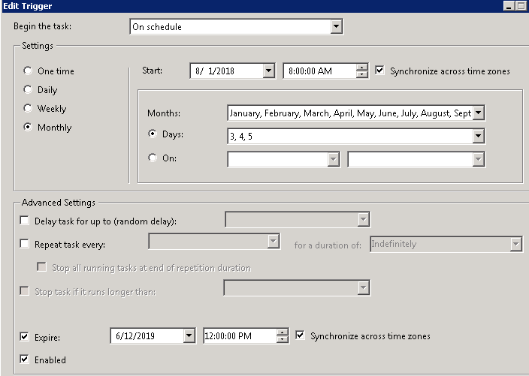
SAS Scheduler
"File" -> "Schedule project_name" -> Click tab "Triggers" -> Edit …

Slide 8
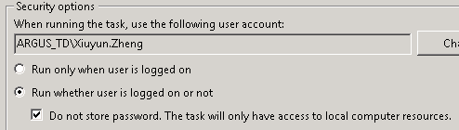
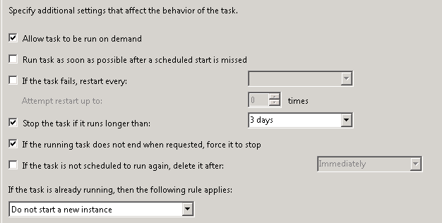
SAS Scheduler – additional notes
'Only run when user is logged on' – otherwise might require admin authorization.
Save the SAS project at local drive/disk!
Scheduler script name – be sure it is executed after renaming.
Other helpful configurations…
  Check tab History for schedule failure info
  Additional settings

Slide 9
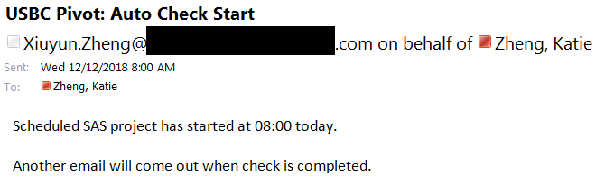
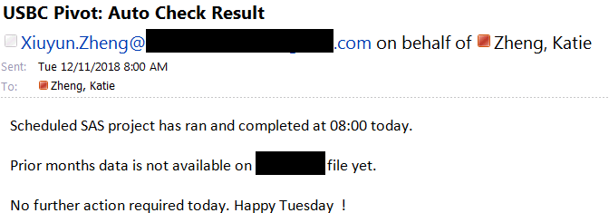
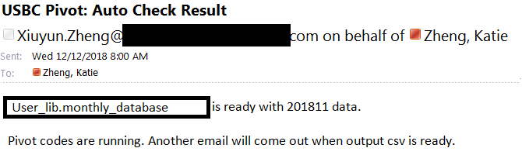
A Final thought
to make the process more fun
Add in the beginning of the code with an email – to remind myself today is the day for reporting!
"Data not available"
Email Check
Point 1
"Data available. Report is running now"

